Slide 1



SHENZHEN CISKO NEW MATERIAL TECHNOLOGY CO., LTD
--The High-Temperature Engineering Plastics Solutions
In Your Side
FROM：CISKO PLASTICS
DATE：14th March, 2025
C
I
S
K
O

Slide 2
01
02
Who We Are?
-About Our Company
What We Have?
-About Our Products
CONTENTS
03
04
Where We Use?
-About Our Applications
Why Choose Us?
-About Our Showcase

Slide 3

Who We Are ?
SHENZHEN CISKO NEW MATERIAL TECHNOLOGY CO.,LTD,
located in Guangdong Province, China, is a specialized supplier of high tem-
perature engineering plastics and specialty modified materials. We maintain
long-term collaborations with globally renowned chemical companies such
as SABIC, Syensqo, BASF, Victrex, and Hanwha Total, while actively promoting
the localization of materials. To further enhance our supply chain network, we distribute domestically produced PEI, TPI/PI, and PEEK from Wanrun.
With a comprehensive plastic raw material supply chain, we provide customers with end-to-end solutions for production and application.
Our key products include PEI, PES, PSU, PPSU, PPEK, Hanwha-Total PP compounds, fluoropolymers, and more. Committed to superior quality and a customer-centric philosophy, our products are exported to the United States, Canada, Japan, the United Kingdom, the Middle East, Southeast Asia, and other regions worldwide.
C
I
S
K
O

Slide 4




Our Team Spirit
ACTION
PROFESSION
COOPERATION
Everything is based on the interests of customers, service-oriented, do a good job in every detail !

Slide 5
Who We Have ?
Our Mainly Products Have:
Part 1:
Plastic raw materials, original products from the genuine factory chemcials, COA, with cerfited docs:
1. Hanhua Total/HTC, Composite PP [Agent]
2. Wanrun PEI, TPI or PI，PEEK， The first brand in China to achieve commercial production of PEI [Agent, strategic partner]
3. Mitsui TPI or PI, PES, PA6T, TPX [Agent]
4. RTP Antepu [Agent]
4. SABIC SPU department, PEI, LNP, PPO, SABIC direct pre-sales and after-sales
5. VICTREX, Solvay PEEK, PAEK， Factory direct pre-sales and after-sales
6. The polysulfone materials of SOLVAY and BASF, PSU, PES, PPSU， Factory direct pre-sales and after-sales
7. DAIKIN Daikin Fluorine Material, SOLVAY Fluorine Material, Factory Direct Pre sales and After sales
Part 2:
Ensinger/Ensinger/Ensinger [Agent] Plastic Plate and Rod Customization, with traceable raw materials and processing capabilities PEI/PEEK/PPSU/PSU/PPS/PC/PP and other medical grade materials or special materials...

Slide 6
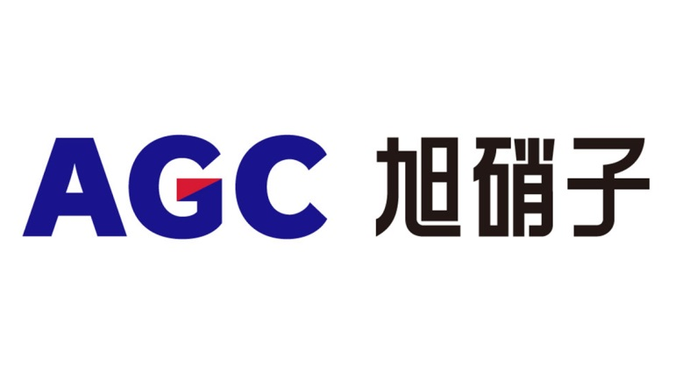


Product Showcase -1st
TEFLON FEP, TEFLON PFA, TEFLON PTFE, TEFLON ETFE...
NEOFLON FEP, PFA,
NEOFLON PTFE, ETFE...
FLUON PFA, FLUON PTFE, FLUON ETFE...

Slide 7

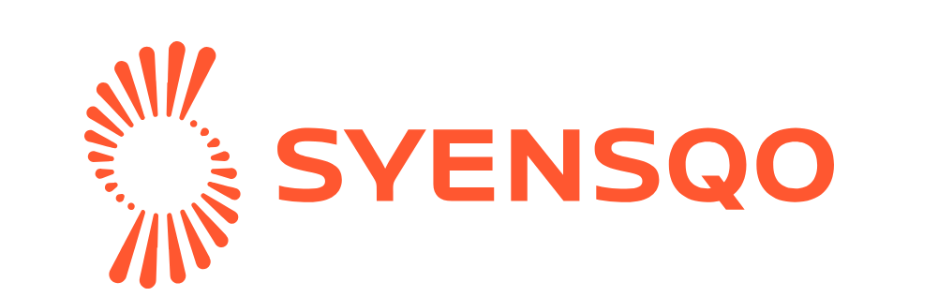

Product Showcase -2nd
VALIANT PEI TPI or PI, PEEK
Hanwha-Total PP COMPOUND
SERIES..
RADEL PPSU, UDEL PSU,
VERADEL PESU/PES,
SOLEF PVDF, RYTON PPS,
LXEF PARA, AMODEL PPA, TORLON PAI...

Slide 8



Product Showcase -3rd
ULTRASON PPSU, ULTRASON PSU, ULTRASON PESU/PES...
EXTEM TPI, ULTEM PEI, LNP SERIES, LEXAN PC, NORYL PPO, CYCOLOY PC/ABC, CYCOLAC ABS, VALOX PBT, GELOY ABS/PC, XENOY PC合金, XYLEX PC合金...
VICTREX PEEK, VICTREX PEK, VICTREX PEKEKK
VICTREX PAEK, APTIV PEEK FIL...

Slide 9










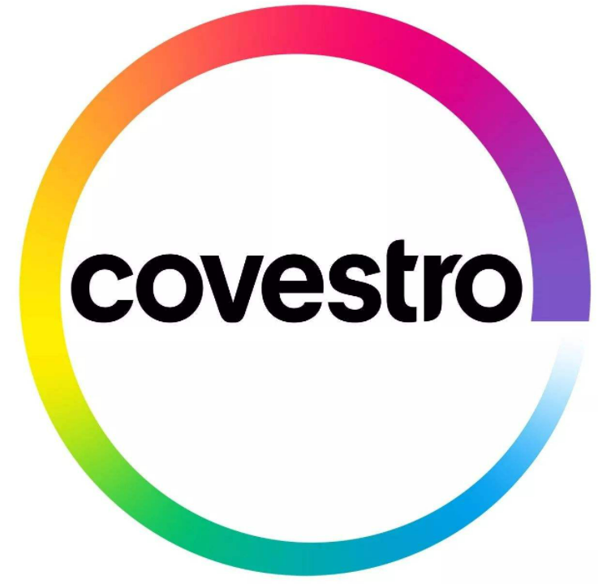






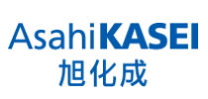


Product Showcase -Other Brands

Slide 10

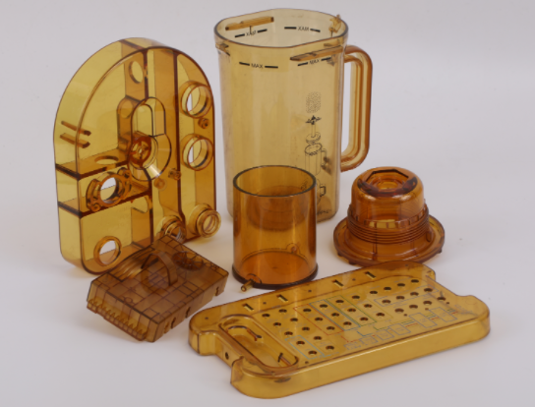
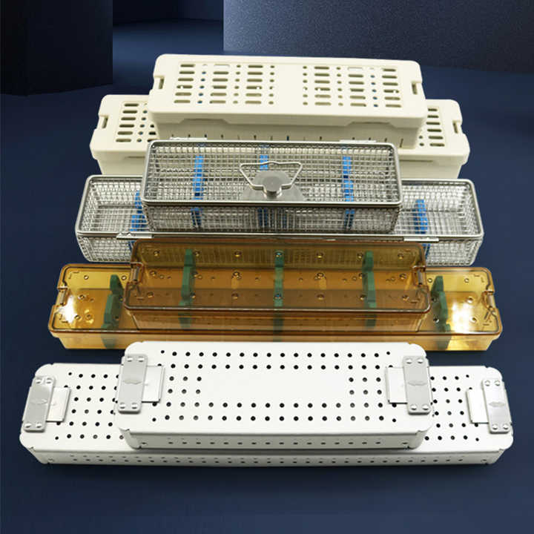
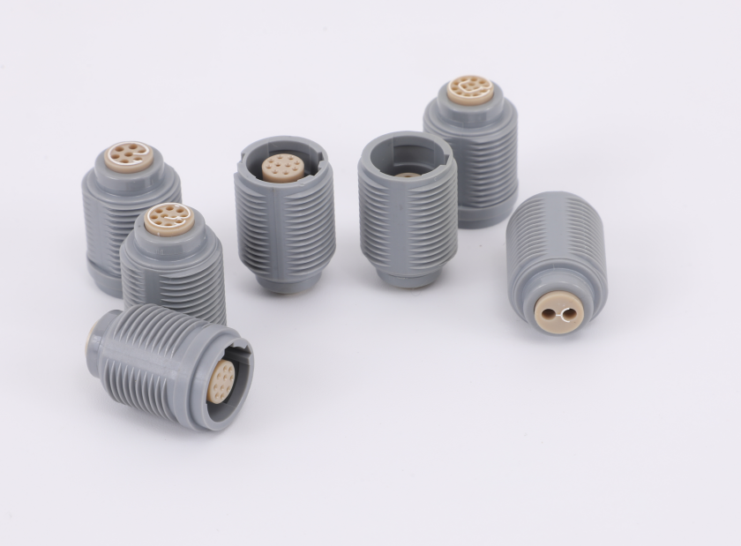
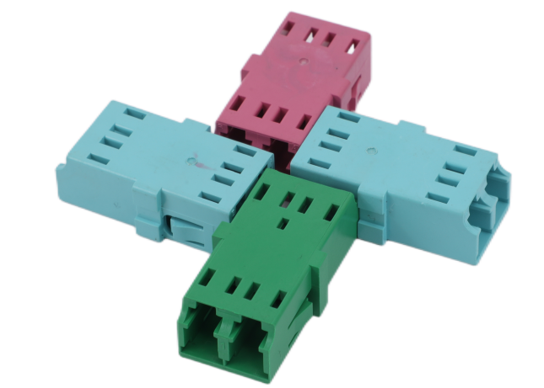
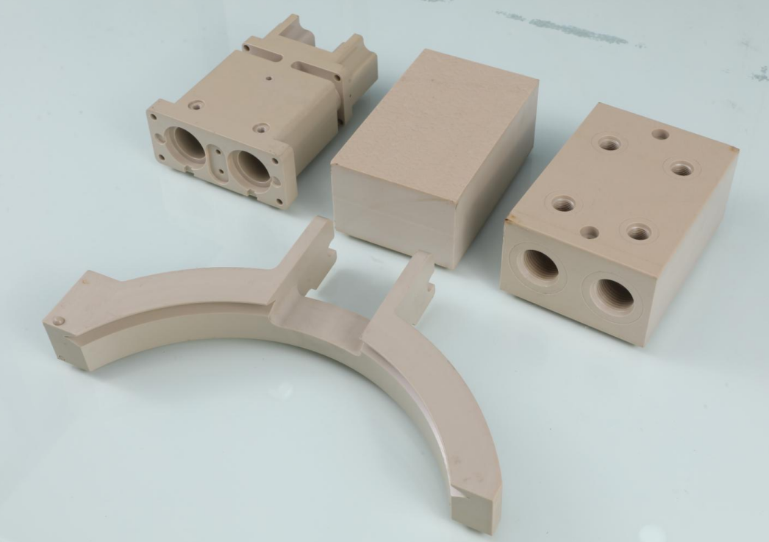
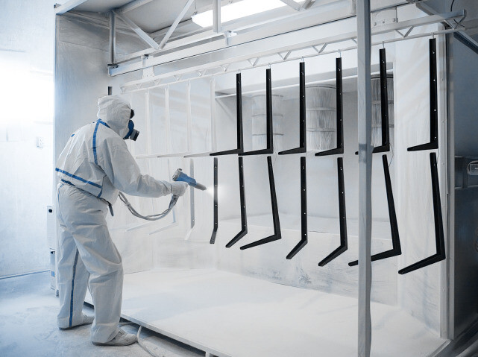
Where We Use ?
Aerospace& Semiconductor
Automotive Energy
Medical Devices
Electronics Applications
Sheets & Shapes
Spraying and coating

Slide 11

Global Customer Base and Market Reach
Diverse Customer Base Across Industries
Cisko has established a strong customer base, with clients from the United States, Canada, Japan, the United Kingdom, the Middle East, Southeast Asia, and other regions. The company’s products are highly regarded for their quality and performance.
The extensive customer base reflects Cisko’s ability to meet the diverse needs of customers from different industries and regions, earning it a reputation as a trusted supplier in the global market.
Long-Term Partnerships and Customer Satisfaction
Why Choose US ?
Cisko’s commitment to customer satisfaction and continuous improvement has led to long- term partnerships with many of its clients. The company’s dedication to providing high- quality products and exceptional service ensures customer loyalty.
By maintaining strong relationships with customers, Cisko gains valuable insights into market trends and customer needs, allowing it to continuously improve its products and services.
Market Presence and Competitive Edge
Cisko’s extensive market presence and strong customer base provide it with a competitive edge in the industry. The company’s ability to offer a wide range of high- performance materials and customized solutions sets it apart from its competitors.
By continuously expanding its market reach and strengthening its customer base, Cisko aims to solidify its position as a leading supplier of high- temperature engineering plastics.

Slide 12






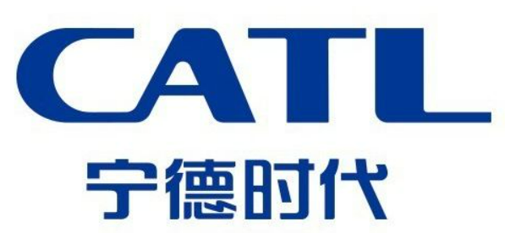


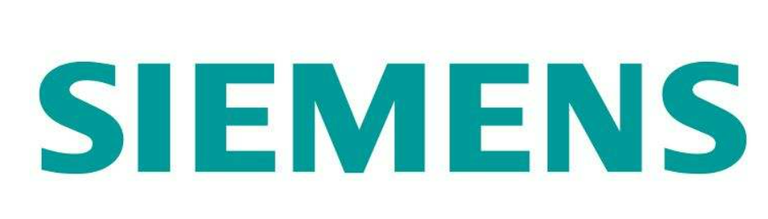
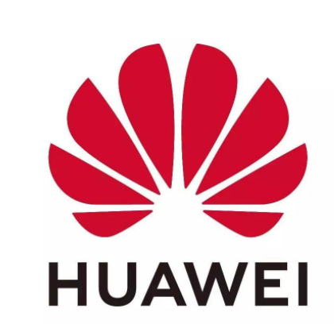




Cooperation Customers
Due to confidentiality part of our customers in shown, not particular order to list of distinguished customers.

Slide 13
Frequently Asked Question (FAQ)
Q: Which material grades do you have?
A: We are mainly in high-temperature and special plastic material advantage supports, as PEI, PEEK, PPSU , PSU and Fluoropolymers, plastic plate and rod, rubber material etc...
Q: Do you have any MOQ limit?
A: For MOQ 25kgs/ 1tons. many brands raw materials support, small qty mixed package and large quantity booking in advance accept.
Q: How about delivery time?
A: In usually small qty will within 3-7 working days after payment, large qty arrange will follow factory production schedule.
Q: How about your payment terms?
A: 100% T/T Prepaid, and online Alibaba trade assurance order accepet.
Q: How about your packing?
Usually 25kgs per bag/carton, 40bags per pallet.
Small qty will packing by our customized paper cartons.
Large qty will packing by plastic pallets export only used.

Slide 14


Thank You
Contact us
Mobile: +86-18923346780
Hotline: 400-000-7127
Email: sunny@ciskotech.com

